Slide 1
Industrial Pharmacy II
By
Dr. Mohammed Sabbar
4th Oct. 2018
http://bit.do/ex2a6

Slide 2
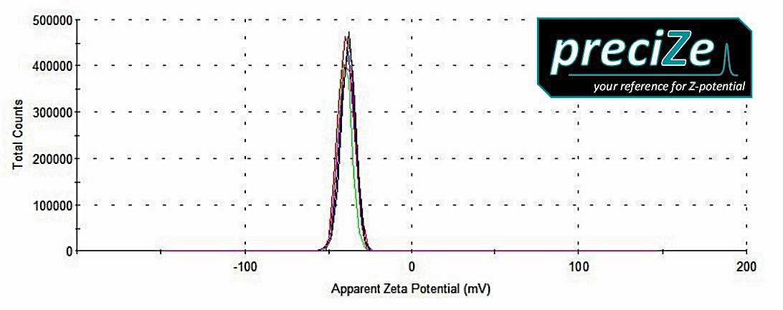
Zeta potential > ± 30mV
The freeze –thaw cycling technique
Additives may enhance or prevent growth of p s
Notes:
Rapid freeze and resting

Slide 3
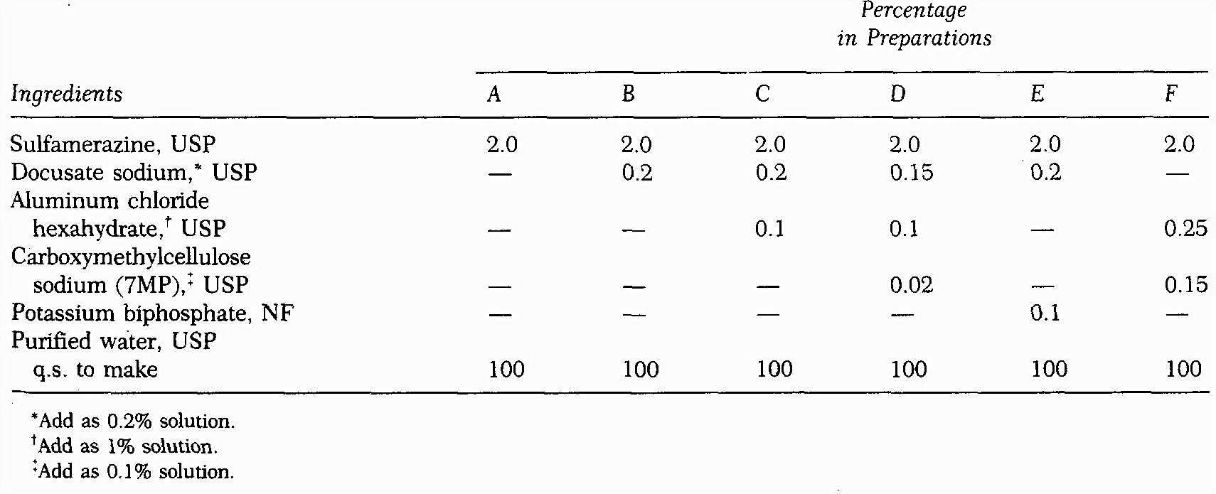

Slide 4
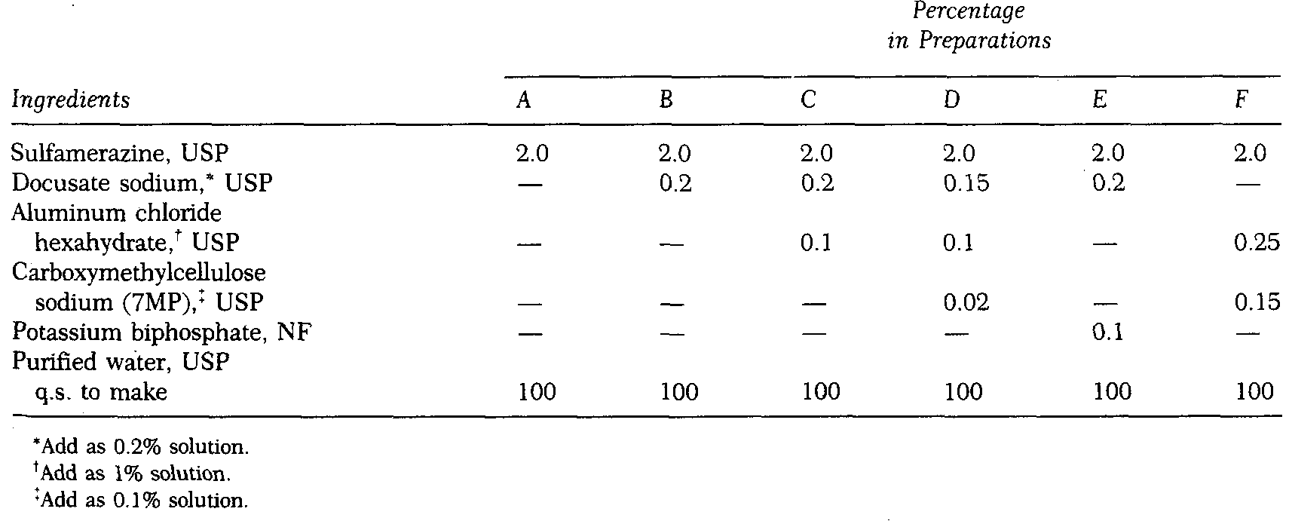
Notes:
A and B demonstrates the value of a wetting agent:
B dispersed sulfa but settles on standing and form cake
C inclusion of aluminum cation (add last)- aggregates rapidly and form high volume of sediment that does not cake and easily re-dispersed
D better than in C because of it contains CMC that acts as protective and viscosity agent and give the aggregated susp. Does not cake on standing and settles more slowly than C

Slide 5
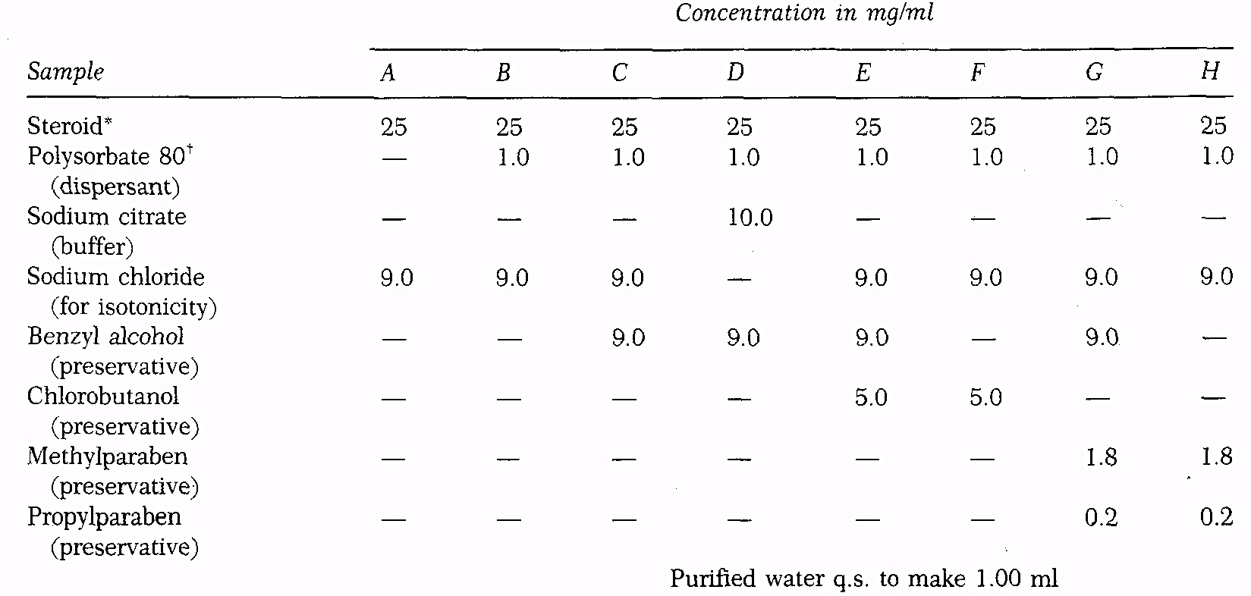

Slide 6
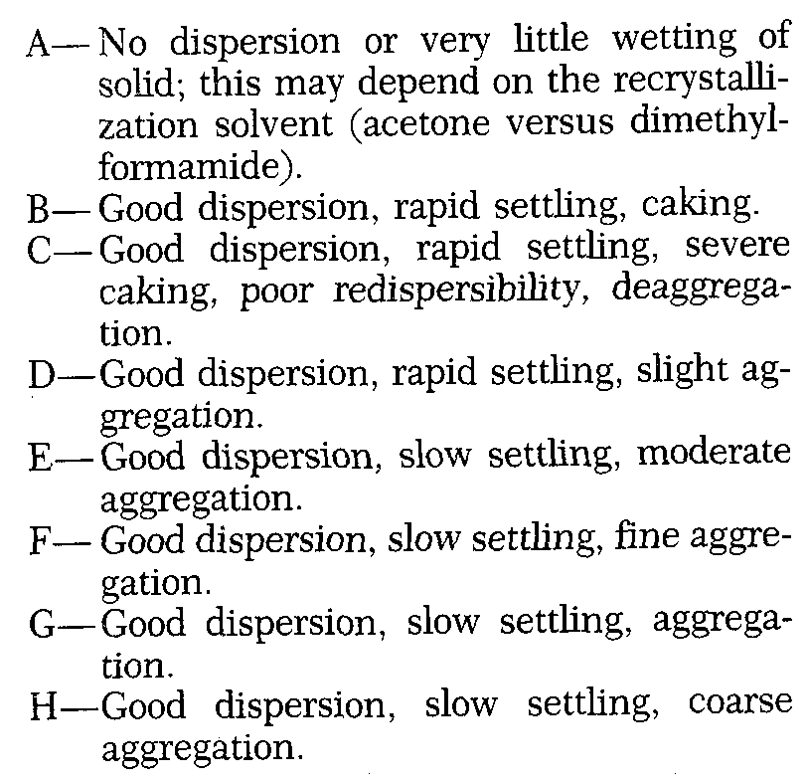

Slide 7
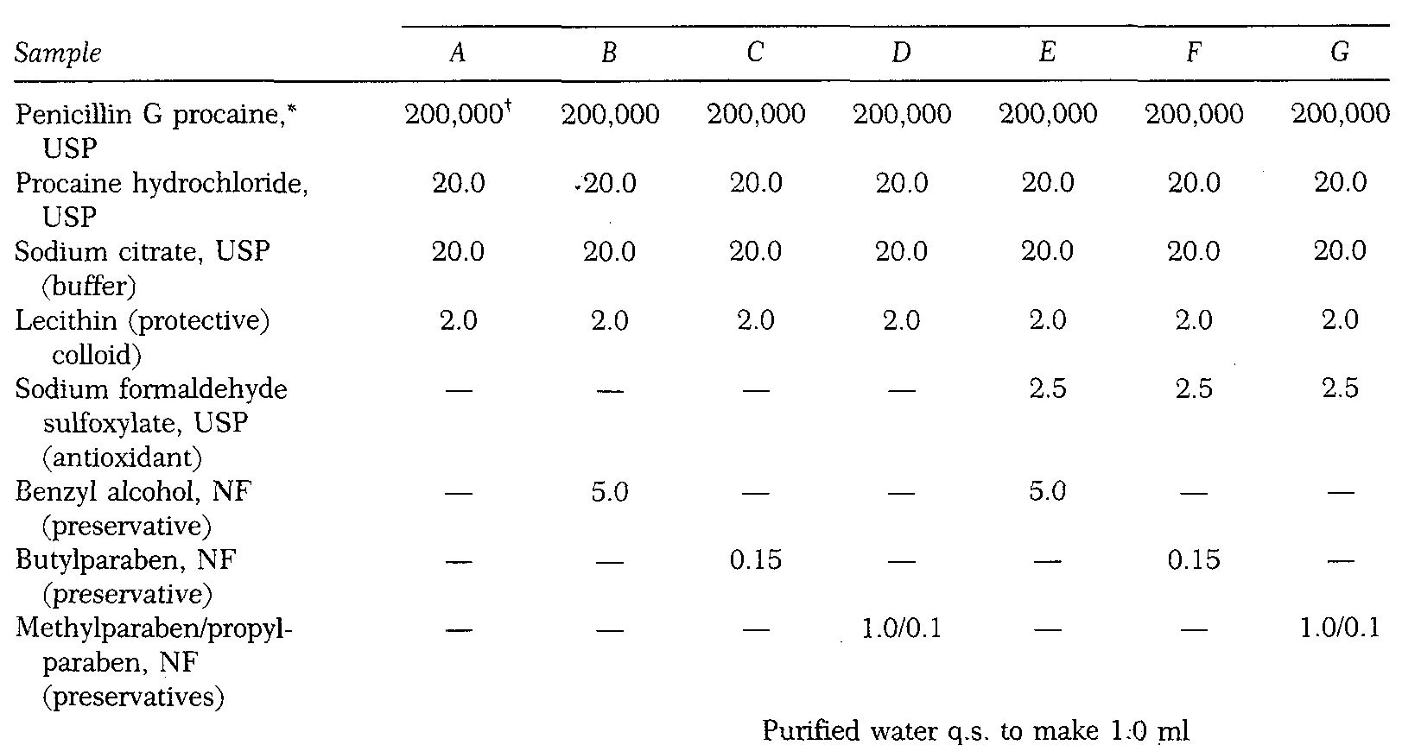

Slide 8
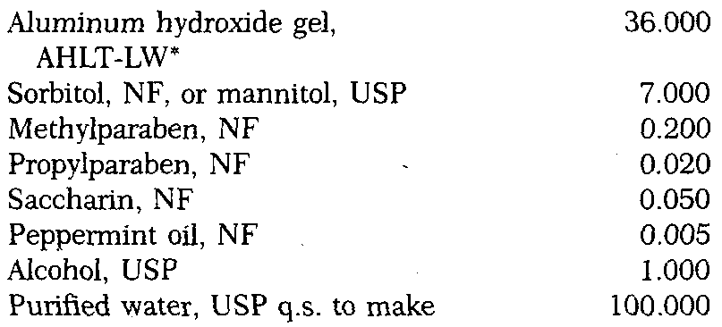
Notes:
All in square are dissolved in ethanol firstly
Al OH dispersed in half volume of water using high speed propeller or dispersor

Slide 9
Biopharmaceutical consideration
Notes:
MgOH is added cathartic effect (prevent constipation)

Slide 10
